Slide 1
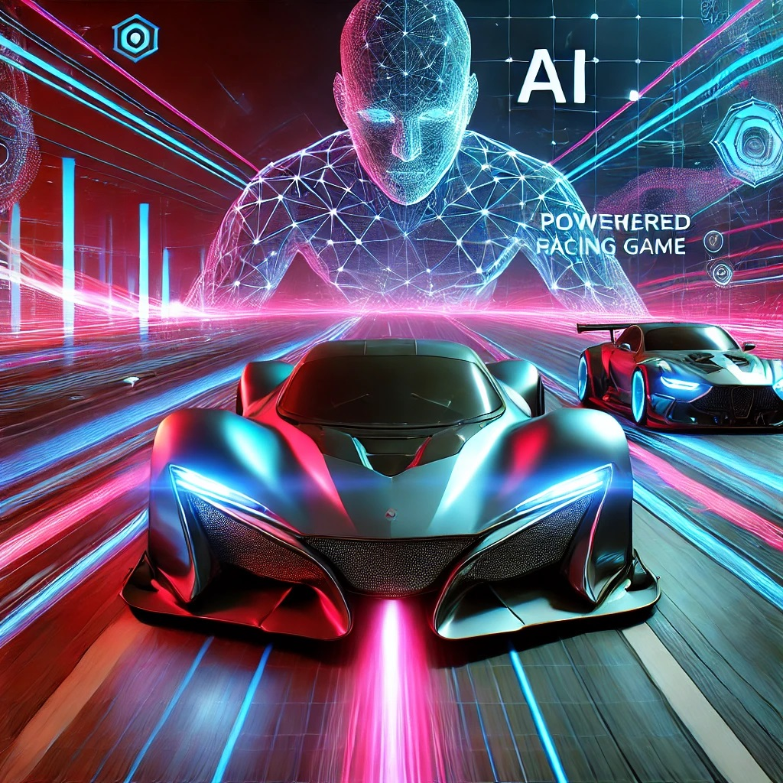
CAR RACING GAME USING AI
Nowshin Nawal Mim 1911054042
Mehrab E Rashid Khan 1931071642
S.M Shamim Sarowar Pranto 1931514642

Slide 2
Game Concept
- A car racing game with AI-controlled cars.
- Players race against AI cars that use reinforcement learning or pre-defined behavior patterns.
- The AI cars simulate realistic movements and adjust strategies based on the player's actions.
What is NEAT?
NeuroEvolution of Augmenting Topologies.
Uses evolutionary algorithms to train neural networks.
Combine genetic algorithm with network topology optimization

Slide 3
Project Overview
Objective: Develop an Ai-powered car racing Agent that simulates real-time decision-making and path-following using machine learning techniques.
Key Features:
Realistic racing environment with dynamic obstacles.
AI-driven vehicles that learn to race by observing and adapting to the environment.
Multiple levels of difficulty to challenge the AI models.
Project Goal: To simulate an AI car's ability to learn and adapt in real-time, improving over multiple races using reinforcement learning algorithms.
.

Slide 4
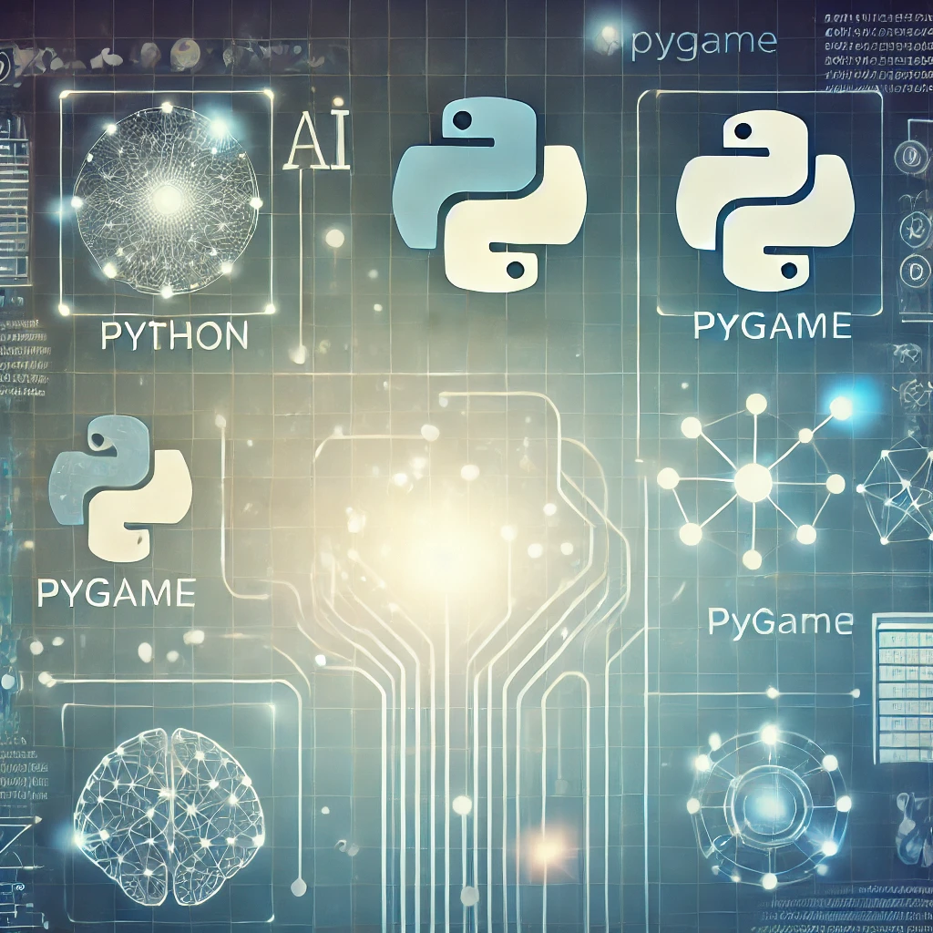
Technologies Used
Programming Language: Python
Game Engine: Pygame
Machine Learning Framework: NEAT (NeuroEvolution of Augmenting Topologies)
Libraries:
Math and OS for utilities
Pygame for game development
Neat-Python for neural network evolution
Tools:
PyCharm IDE for development
Custom assets and graphics for car and track

Slide 5
Game Concept - A car racing game with AI-controlled cars. - Players race against AI cars that use reinforcement learning or pre-defined behavior patterns. - The AI cars simulate realistic movements and adjust strategies based on the player's actions.
AI Technology Use
- Reinforcement Learning: AI learns optimal racing strategies through trial and error.
- Neural Networks: Used for predicting racing behavior and adjusting to the player's actions.
- Pathfinding Algorithms: AI cars follow racing tracks and avoid obstacles efficiently.

Slide 6
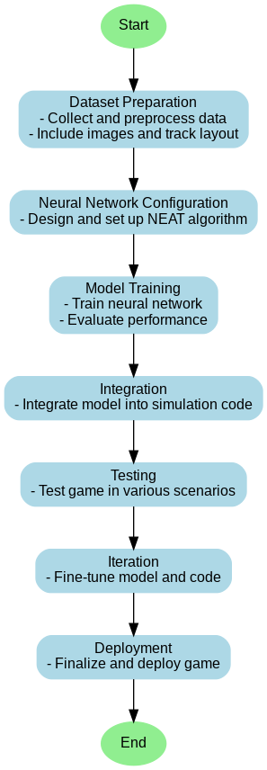
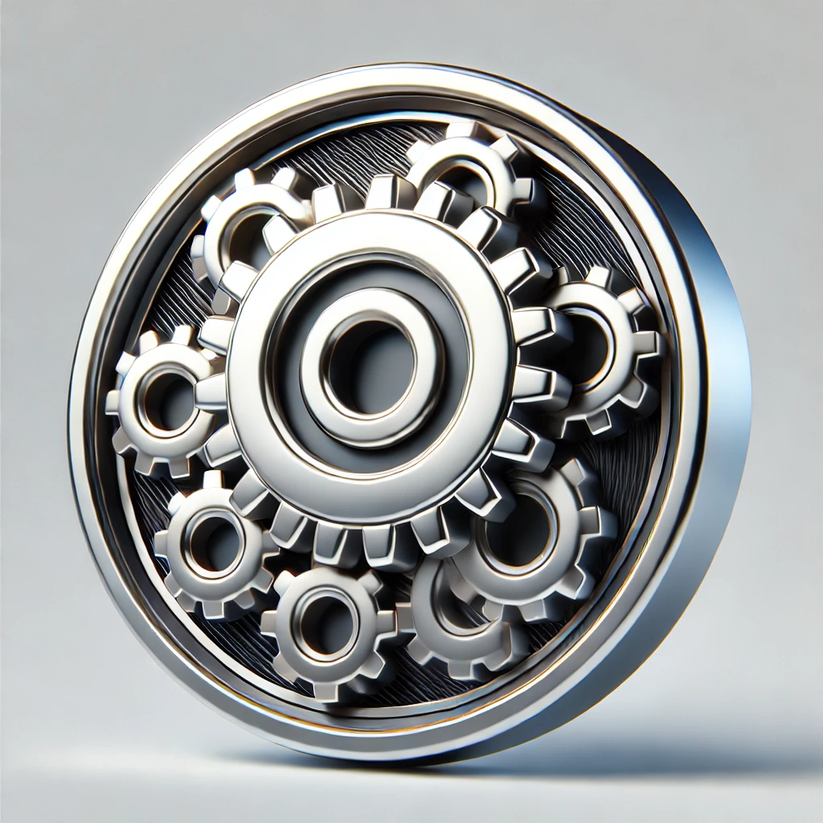
Project design

Slide 7
How AI Powers the Racing Game
- AI algorithms control car acceleration, braking, and steering.
- AI cars detect player positions and use decision-making processes to optimize their own moves.
- AI adapts to the difficulty level, providing players with a challenging racing experience.

Slide 8
Game Development Process
1. Concept Development: Define game mechanics, AI behavior, and overall game structure.
2. AI Implementation: Develop reinforcement learning models and pathfinding algorithms.
3. Game Testing: Conduct playtesting to fine-tune AI behavior and player experience.
4. Polishing: Improve graphics, AI responsiveness, and optimize performance.

Slide 9
Challenges and Solutions
- Challenge: AI Cars Struggling with Complex Tracks
Solution: Improved pathfinding algorithms to navigate turns and obstacles.
- Challenge: Overpowering AI Difficulty
Solution: Adjusted reinforcement learning models to create dynamic difficulty levels.

Slide 10
Conclusion & Future Work
- AI has significantly improved the gaming experience by creating dynamic, responsive racing opponents.
- Future Work: Incorporate multiplayer features, improve AI learning, and enhance car behavior simulation.

